Slide 1




Communicate.AI:
Using Computer Vision and AI to Overcome Language Barriers in Real Time
Arnav Deol, James Ashworth, Ankit Mudunuri, Joseph Khalaf
1
Notes:
Good afternoon – our names are Arnav Deol, Ankit Mudunuri, and Joseph Khalaf.
Growing up, we thought of a more global world. Not only a world where we can travel anywhere we like, eat food from all cultures, or listen to regional music, but a world where we can understand everyone around us... regardless of the language they speak.
This is how we used computer vision and AI, to overcome language barriers in real time.

Slide 2
Purpose
Live-Translate Languages in a Non-Intrusive Method
Proof-of-concept for Augmented Reality Technology
Enabling Hard of Hearing Individuals to More Actively Participate in Social Interactions
Notes:
Ankit – When thinking of a purpose for our initial design, we focused on a three pronged approach to move forward with:
Briefly explain each of the aspects above

Slide 3
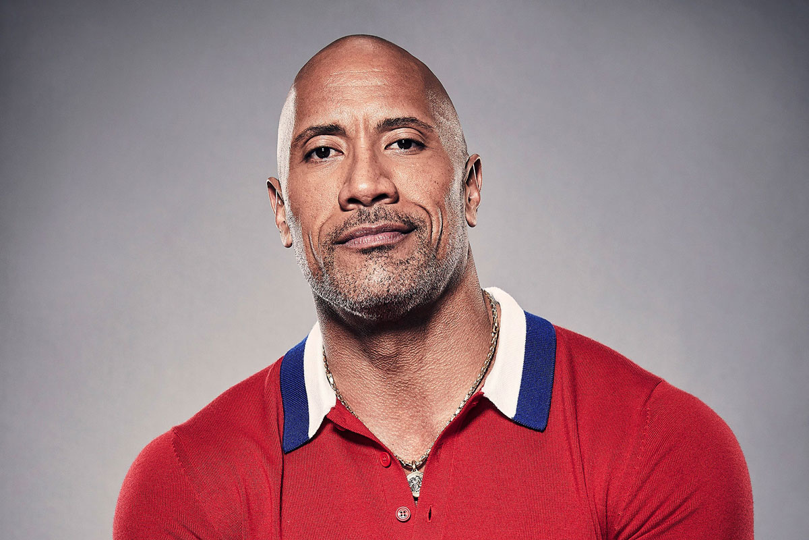
Program Features
Notes:
Joe – For the next 4 slides, make it very obvious what our program is able to do. Completely explain and slow down what is happening when someone talks in real time.
Someone talks --> the text is transcribed --> the text is translated --> the translated text is output --> the text box for the output dynamically moves to follow the speaker

Slide 4
Program Features
Face Detection to Actively Track Where a Person in on Screen

Slide 5
Program Features
Hi my name is Dwayne

Slide 6
Program Features
The text is dynamically adjusting to the position of the face box for each frame.
For instance, if The Rock ducks, the text box will move above the face box
Translates to a Language of the User’s Choice and Subtitles in Real Time
Hola mi nombre es Dwayne

Slide 7



How It Works
Uses Google Cloud API for Speech-to-Text and Text-to-Speech
Uses Google Translate for Language Translation
OpenCV for Facial Detection
Multi-Threaded Processing for Optimization of Code
Notes:
Ankit - Emphasize the different tools we used and what aspects they are directly related to

Slide 8

Social Impact
Increase Multicultural Connectivity
Workplace Developments
Enhanced Multilingual Collaboration
Streamlined Communication Channels
Enhances Travel Experiences
Notes:
Arnav – Use your emotional appeal to heavily lean on the social impact this will have. Do not talk about the travel experiences as it is not important, just a cool last bullet to have instead.

Slide 9
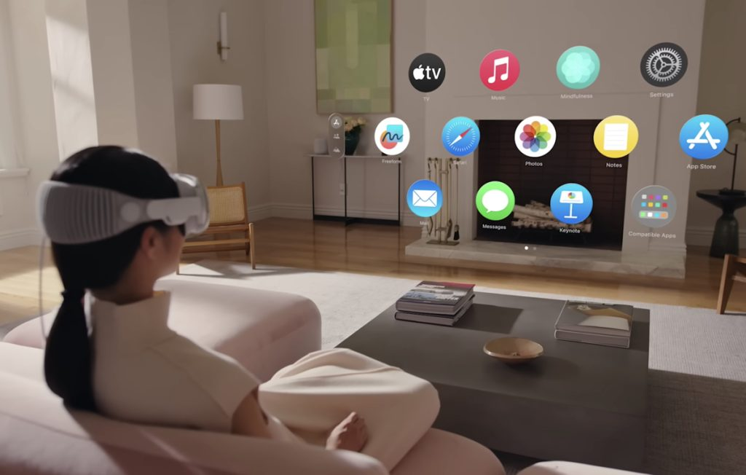
Future Improvements and Current Issues
Make the Program More Accessible
Plug-in for Apps such as Zoom
Compatibility for Tomorrow’s Technology such as the Vision Pro
Build an Integrated User Experience
Change the Language from Python to Improve Processing Speed
Improve the Program’s Utilization of Modern Serverless Computing Systems
Notes:
Joe – Quickly go over what the different aspects of this slide

Slide 10
Questions?
+Live Demonstration
Notes:
TAKE TURNS ANSWERING THE QUESTIONS.
They do not want to think only one person did the project because he answers all the questions.
Only answer a question if you are confident that you know the answer, though

